Slide 1
AI & MACHINE LEARNING PROJECT • TEAM (GROUP E40B)
Tashkent Apartment Price Prediction
Exploratory data analysis and Multiple Linear Regression modeling on Uybor.uz listings.
Oydinov Bexruz (202390243)
Murtazoyev Xondamir (202390241)
Sayfulloyev Muhammad (202390201)
Abdumurodov Mashrab (202390257)

Slide 2
TEAM STRUCTURE • SPEAKER 1: BEXRUZ OYDINOV
Team Roles & Presentation Flow
2. Xondamir Murtazoyev
3. Muhammad Sayfulloyev
4. Mashrab Abdumurodov
1. Bexruz Oydinov
Team Leader (202390243)
CPO (202390241)
Researcher (202390201)
Prompt Eng (202390257)
Problem & MLR Model
Pipeline & Features
EDA & Market Insights
Evaluation & Web App

Slide 3
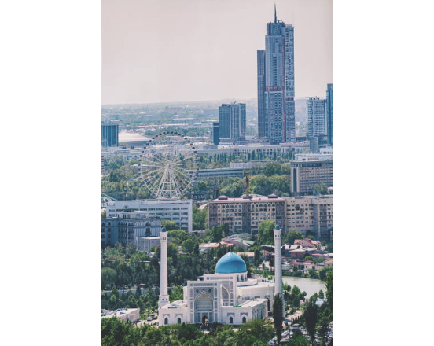
PROJECT CONTEXT • SPEAKER 1: BEXRUZ OYDINOV
Market Problem & Research Objectives
Subjective Pricing: Wide valuation gaps across Tashkent listings.
Core Objective: Predict fair USD value via regression.
Spatial Factor: Quantify price premiums across 12 districts.
Interpretability: Measure exact dollar impact per feature.

Slide 4
DATA SOURCE • SPEAKER 2: XONDAMIR MURTAZOYEV
Uybor.uz Tashkent Real Estate Dataset
7,421
Scraped Apartment Listings Across 12 Tashkent Districts
9 raw attributes including area (m²), rooms, floor level, price (USD), and GPS coordinates.

Slide 5
PREPROCESSING • SPEAKER 2: XONDAMIR MURTAZOYEV
Four-Stage Data Cleaning Pipeline
01
02
03
04
Deduplication
Floor Logic Check
Outlier Trimming
Clean Dataset
Dropped 696 duplicate rows.
Enforced level below max_levels.
Filtered 1st to 99th percentiles.
6,360 verified housing records.

Slide 6
DOMAIN FEATURES • SPEAKER 2: XONDAMIR MURTAZOYEV
Engineered Features for Regression
Center Proximity (dist_from_center_km)
Floor Position Indicators
Haversine distance to Amir Temur Square.
Binary flags for top and first floors.
Room Spaciousness (sqm_per_room)
One-Hot District Encoding
Total area divided by room count.
11 binary columns avoiding multicollinearity.

Slide 7
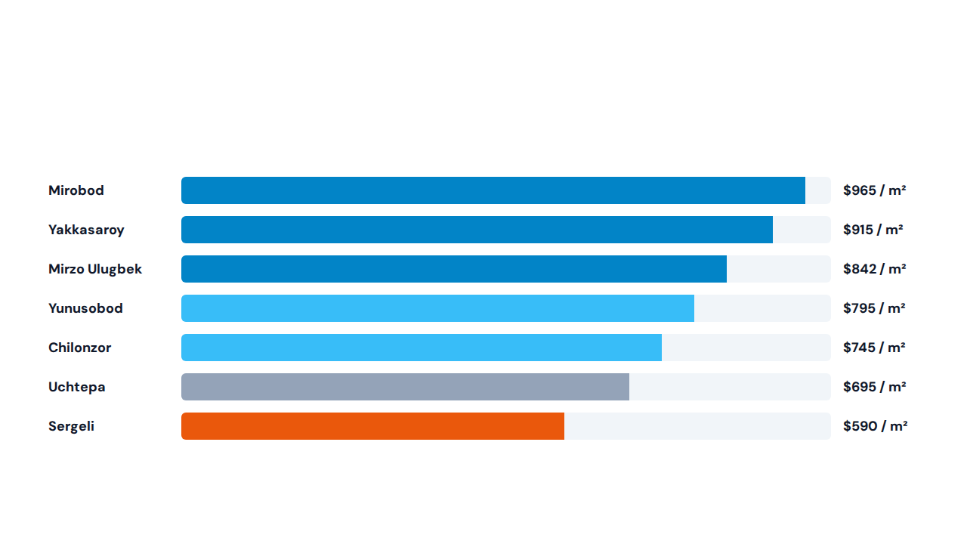
EXPLORATORY DATA ANALYSIS • SPEAKER 3: MUHAMMAD SAYFULLOYEV
Average Price per Square Meter ($/m²) by District

Slide 8
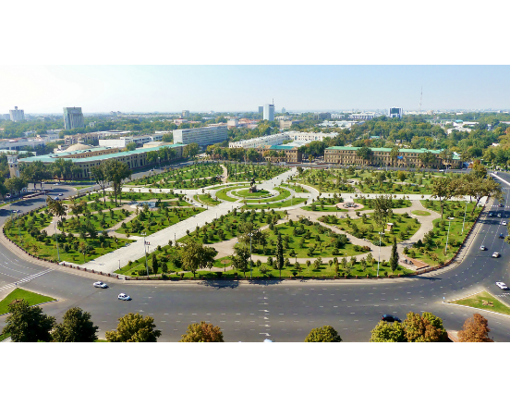
KEY DRIVERS • SPEAKER 3: MUHAMMAD SAYFULLOYEV
Key Price Drivers & Spatial Trends
Living Area (r = 0.81): Strongest linear driver of apartment price.
Room Count (r = 0.62): High positive correlation with total size.
Center Distance (r = -0.34): Prices drop sharply outside central ring.
Top Floor Discount: Top floors trade lower in unrenovated buildings.

Slide 9
MODEL COEFFICIENTS • SPEAKER 1: BEXRUZ OYDINOV
Multiple Linear Regression Learned Weights
Model Feature | Learned Coefficient | Market Interpretation
Total Area (size) | +$868.50 / m² | Marginal dollar increase per square meter
District: Mirobod | +$11,850 | Executive central location premium
District: Yakkasaroy | +$9,200 | Central residential district premium
District: Mirzo Ulugbek | +$6,450 | High-demand eastern central premium
Distance to Center | -$1,620 / km | Price drop per km from Amir Temur Square
Top Floor Indicator | -$2,450 | Top floor discount vs middle levels

Slide 10
VALIDATION RESULTS • SPEAKER 4: MASHRAB ABDUMURODOV
Model Evaluation on 20% Unseen Test Set
0.742
$8,900
$12,450
0.738
Test R² Score
Mean Absolute Error
Test RMSE
5-Fold CV R²
74.2% variance explained
Average dollar deviation
Root mean squared error
Consistent generalization

Slide 11
LIVE DEPLOYMENT • SPEAKER 4: MASHRAB ABDUMURODOV
Interactive Predictor Test Scenarios
MIRZO ULUGBEK
YAKKASAROY
CHILONZOR
$65,185
$59,610
$40,540
3 rooms • 75 m² • Floor 4/9
2 rooms • 65 m² • Floor 3/5
2 rooms • 55 m² • Floor 2/4

Slide 12
TEAM • GROUP E40B
Thank You & Q&A
Live demo of our Jupyter Notebook and Interactive Price Predictor available now.
https://sites.google.com/view/real-estate-price-predictor/full-page-embed

